Slide 1
Agriculture

Slide 2
Introduction
What is agriculture?
What products do we get from agriculture?
Is agriculture important to your everyday life? Why or why not?

Slide 3
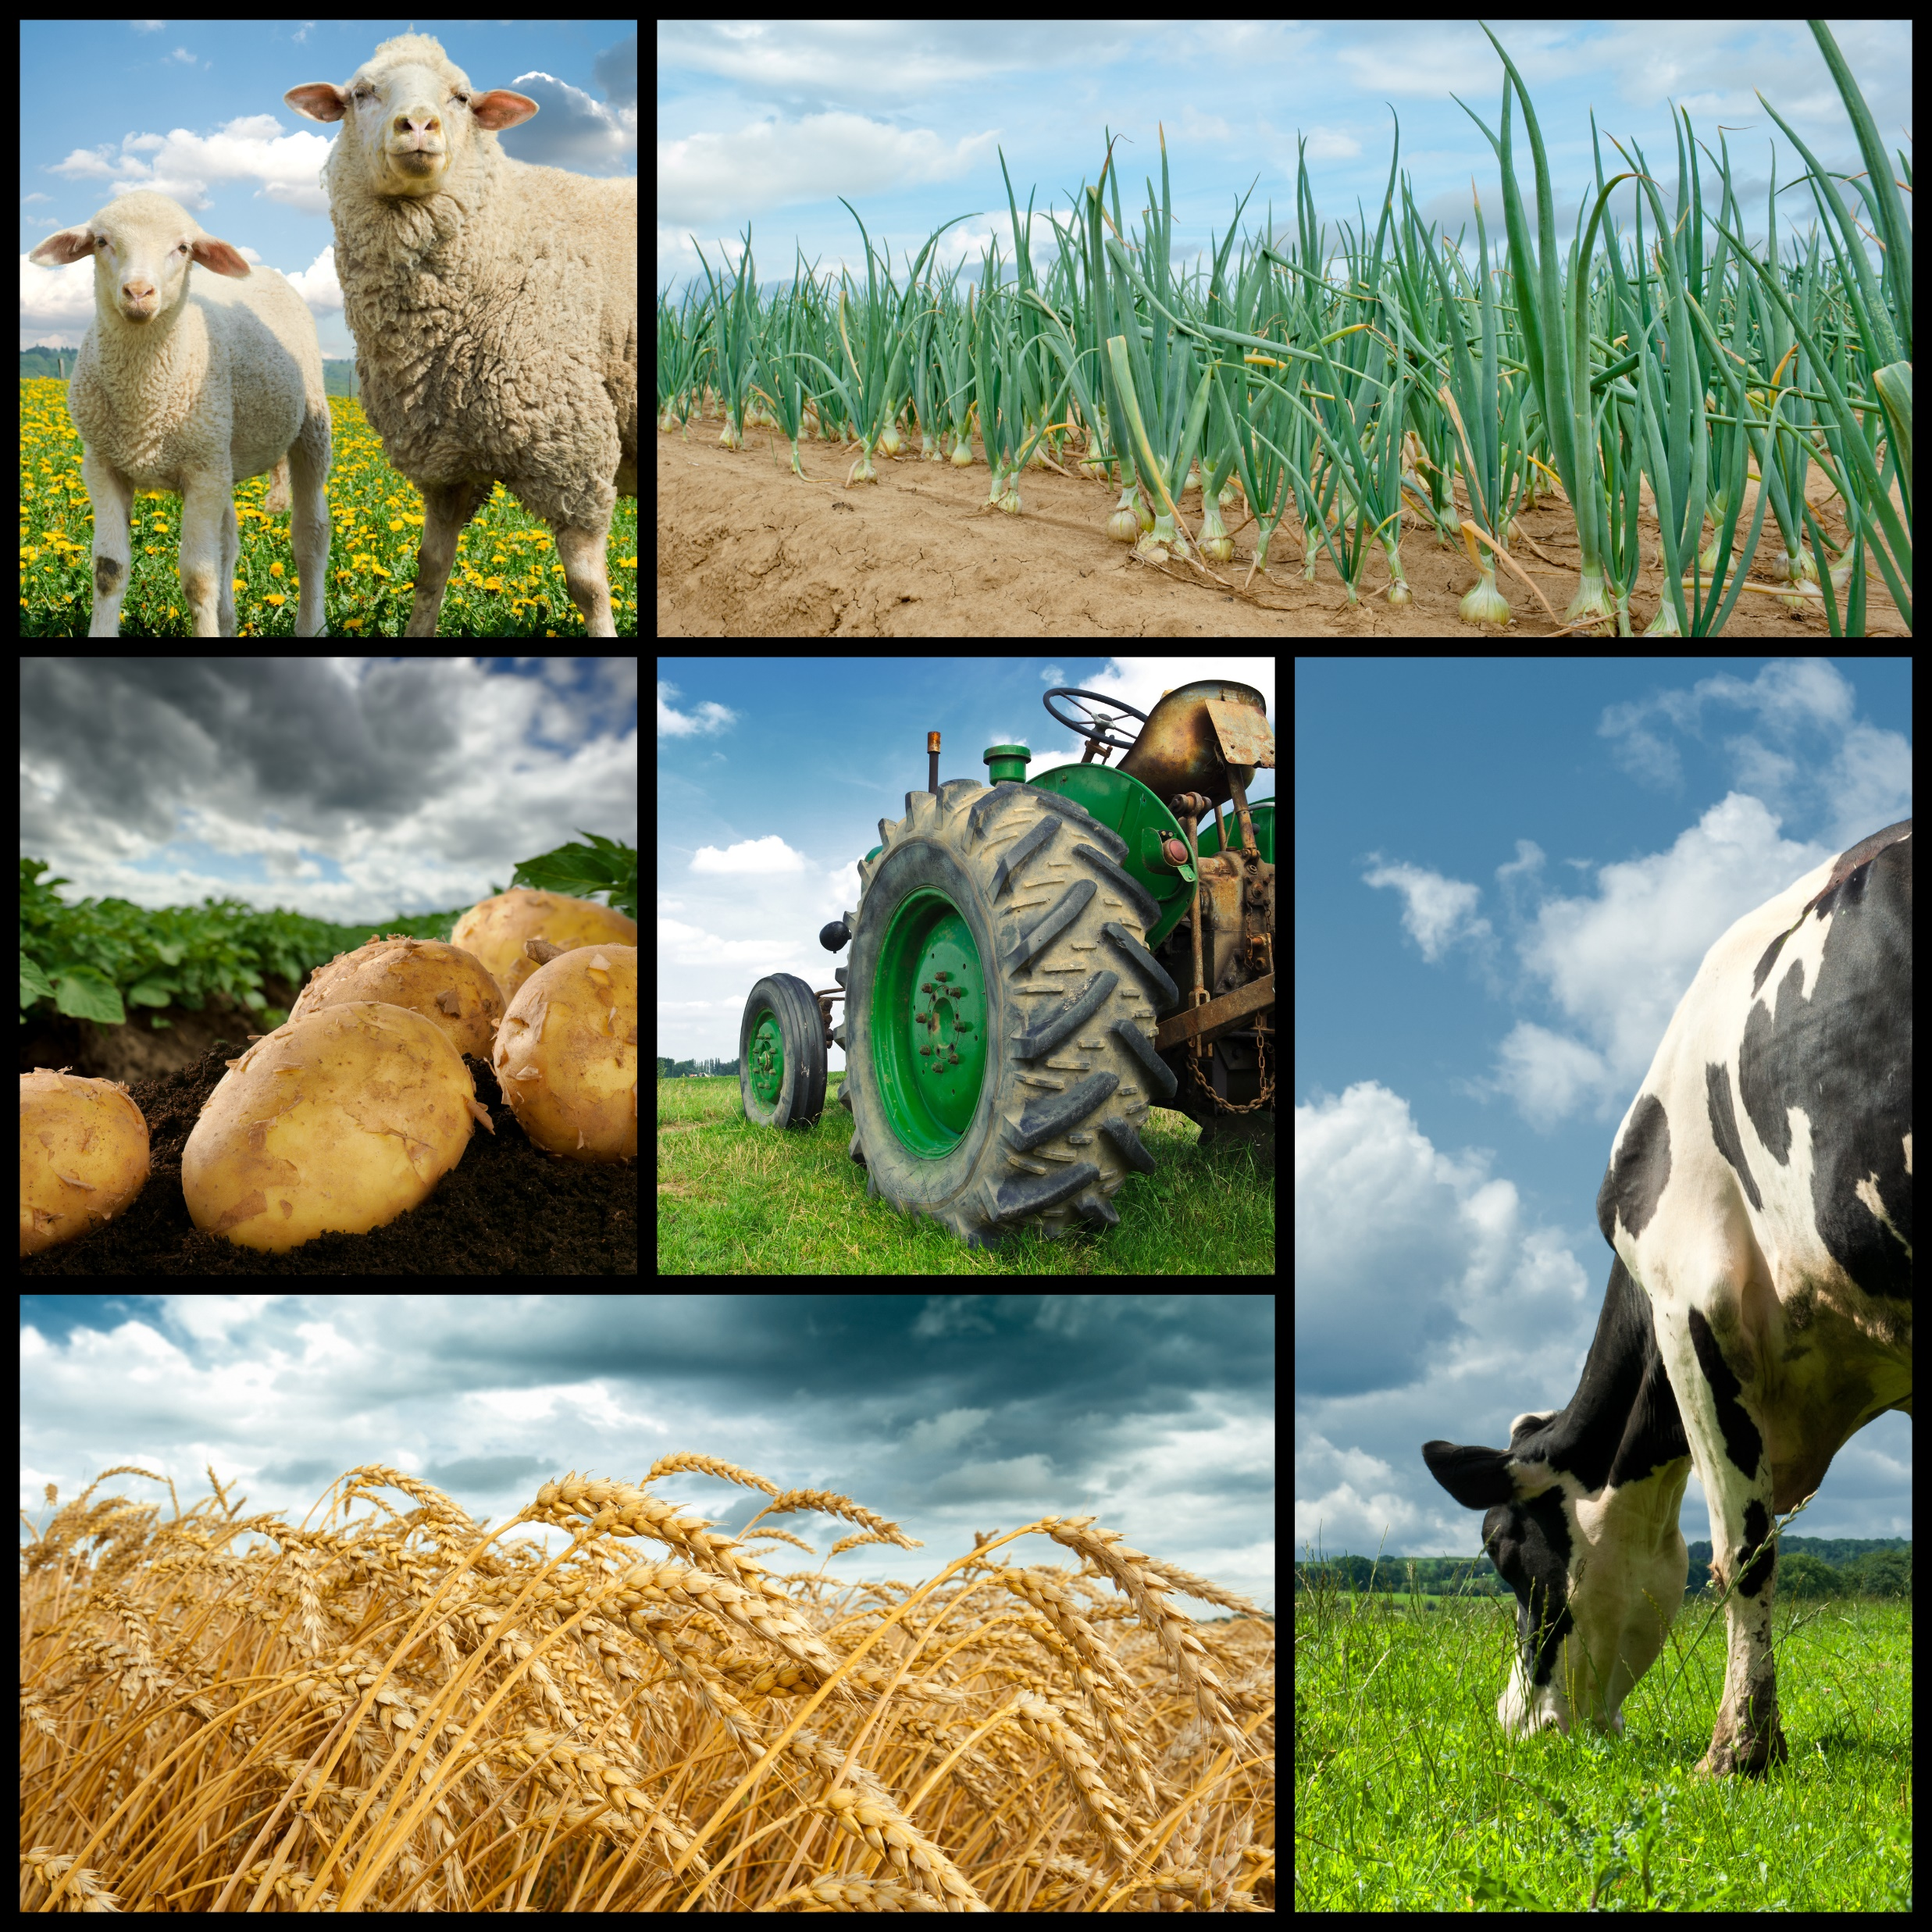
What is Agriculture?
Is the science of growing plants and rearing animals. It includes:
Processing them into various forms to provide food, fuel, fiber and other products for use.
Agriculture involves the care and management of natural resources such as soil, water, air, forests and wildlife.

