Slide 1
Agriculture

Slide 2
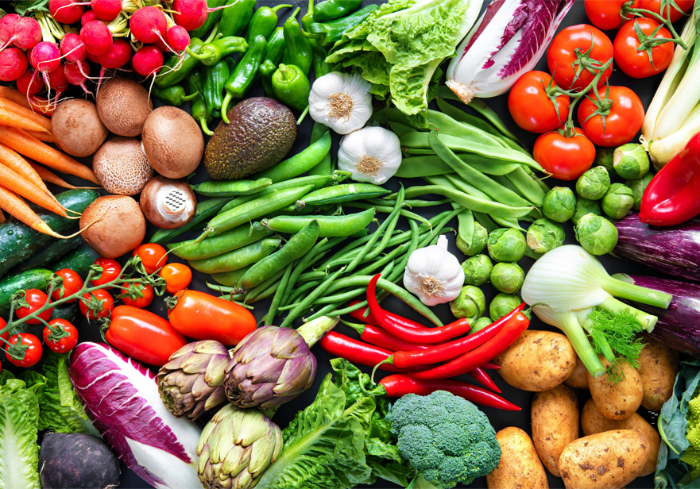
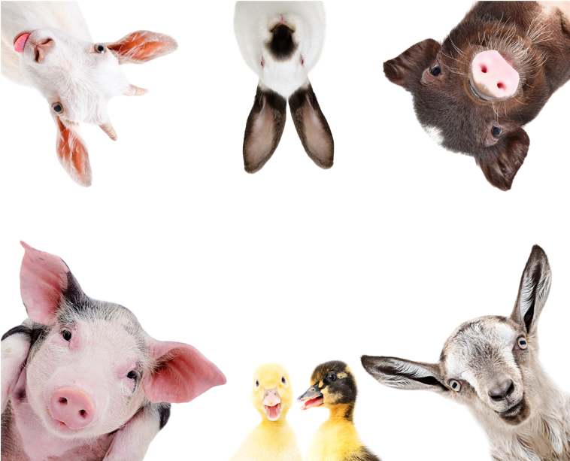
Plants and Animals

Slide 3
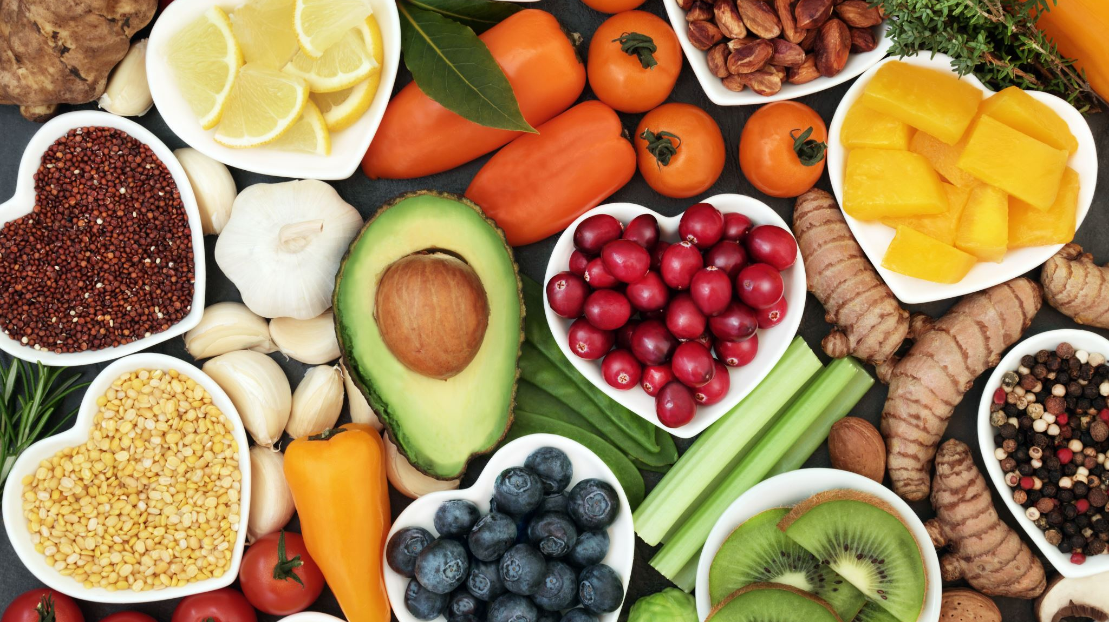
Introduction
How and why are plants and animals used in society?
How are plants and animals turned into food or other products for humans?
Do plants and animal products play a role in human health and medicine? If so, how?

Slide 4
Game
Match the following plants and animals with their appropriate products

