Slide 1
Agriculture

Slide 2
Soil
2

Slide 3
Introduction
What is soil?
What makes a soil suitable for plants?
What does the soil provide for plants?

Slide 4
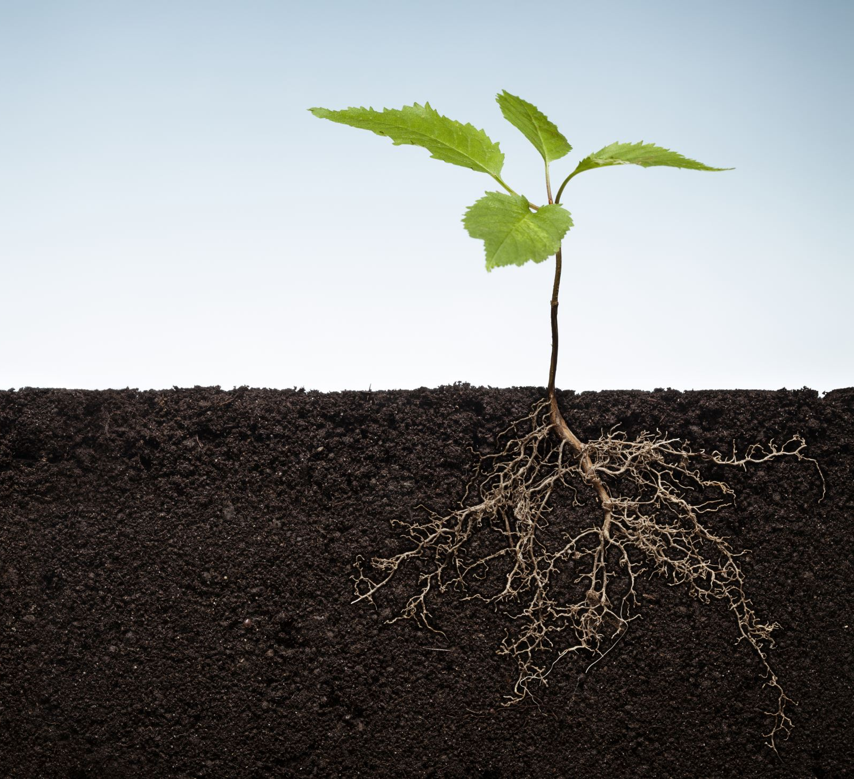
What is Soil?
Is the surface mineral and/or organic layer of the Earth that has been partially broken down by environmental processes. In agriculture, soil refers to the “dirt” in which plants grow.

