Slide 1

Agriculture

Slide 2

Water

Slide 3
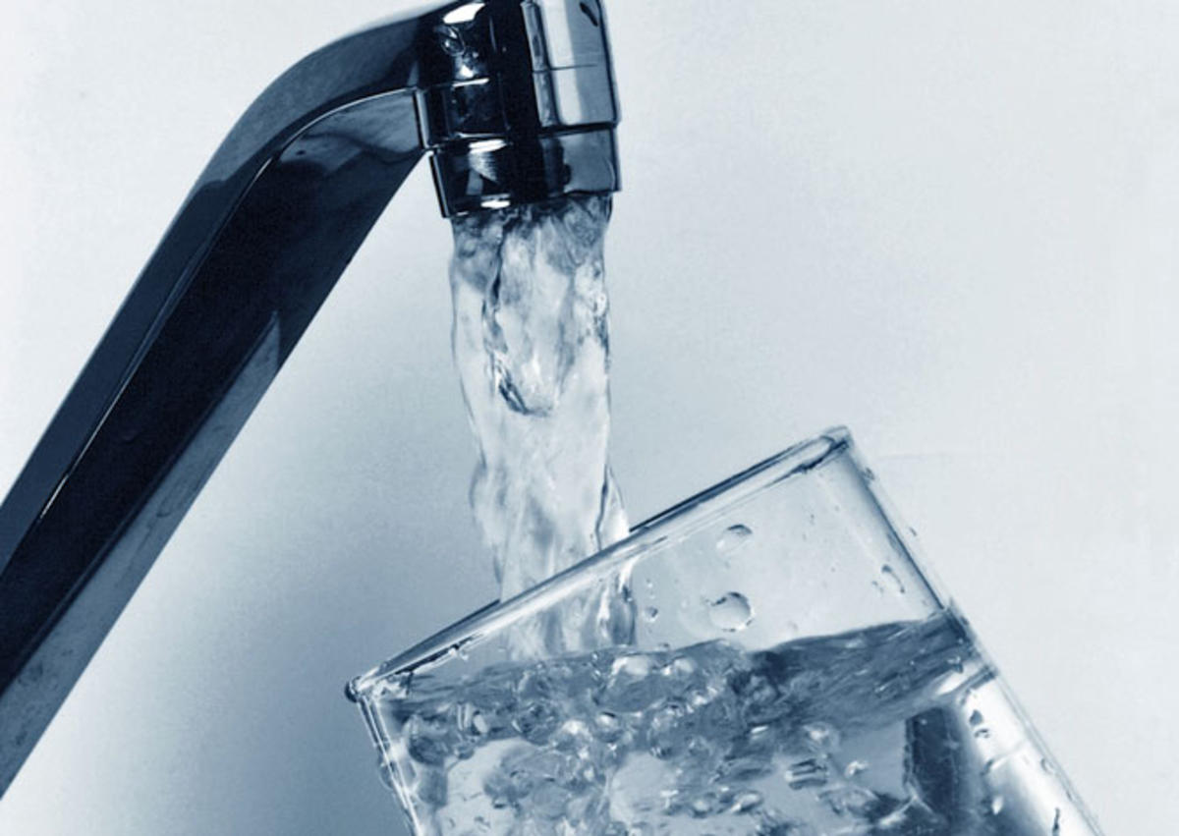
What percentage of the Earth is water? Can all types of water on Earth be used for drinking and agriculture?
Why is water necessary for agriculture? How is water used by agricultural activities?
Is there also freshwater below the ground? How might it be accessed?

Slide 4
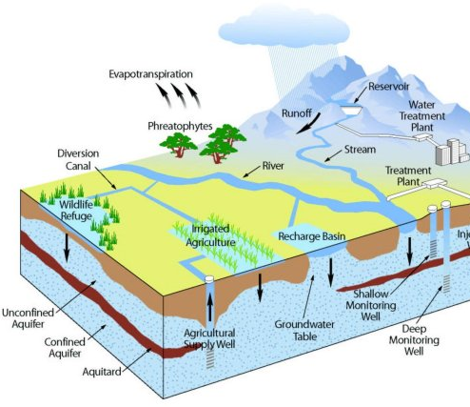
What is an Aquifer?
An underground layer of sand, gravel, or rock whose many holes contain a usable supply of groundwater.
They are accessed by drilling and operating wells that supply water for irrigation, homes, power plants and factories.
This Photo by Unknown Author is licensed under CC BY-SA

Slide 5
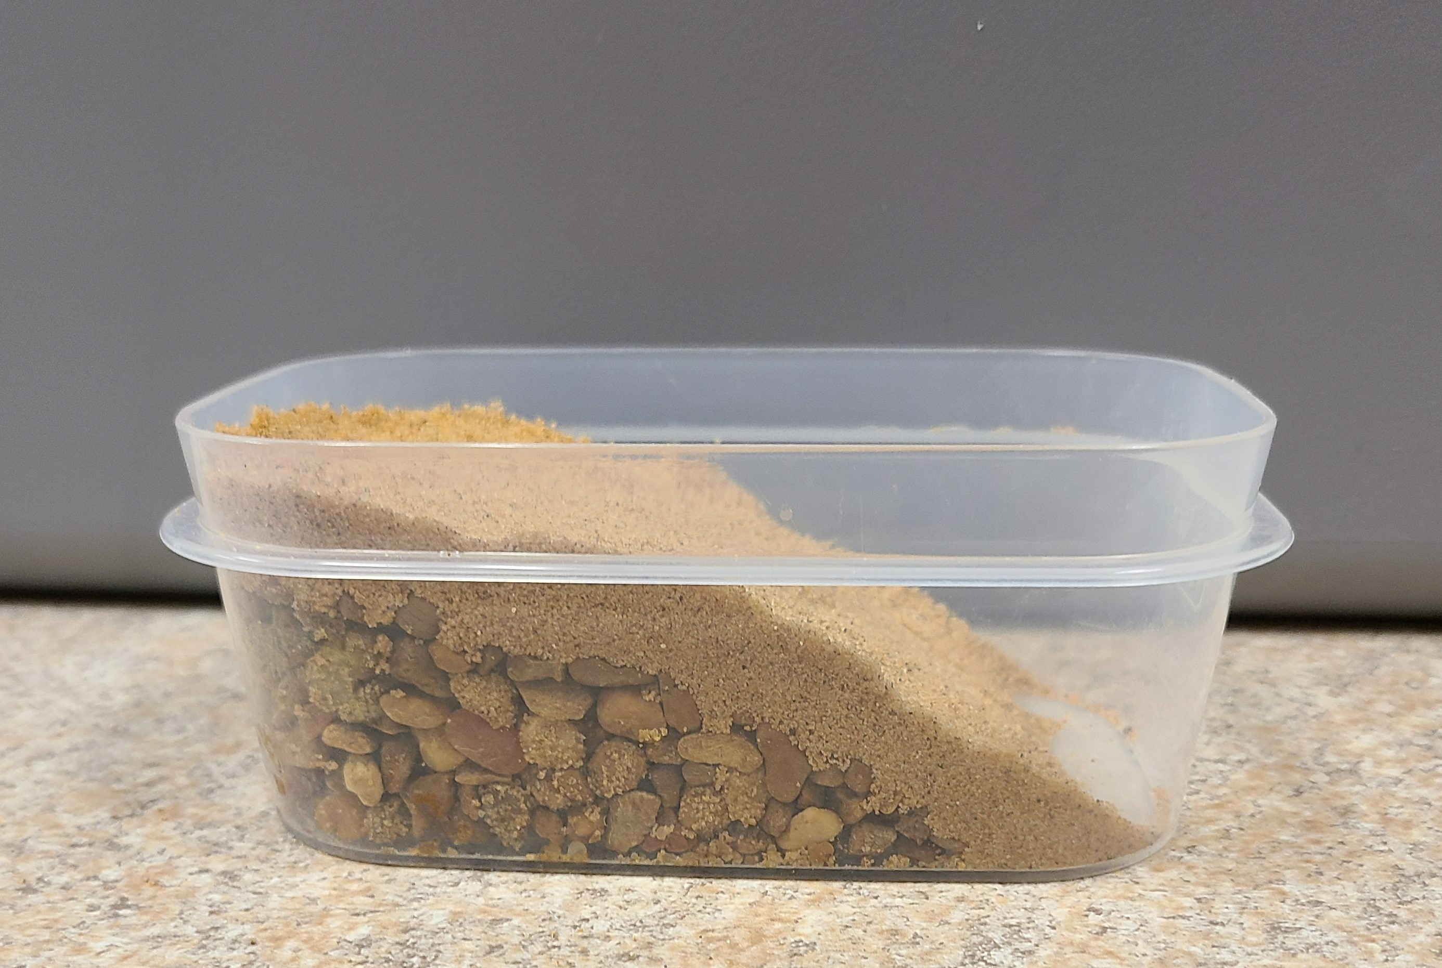
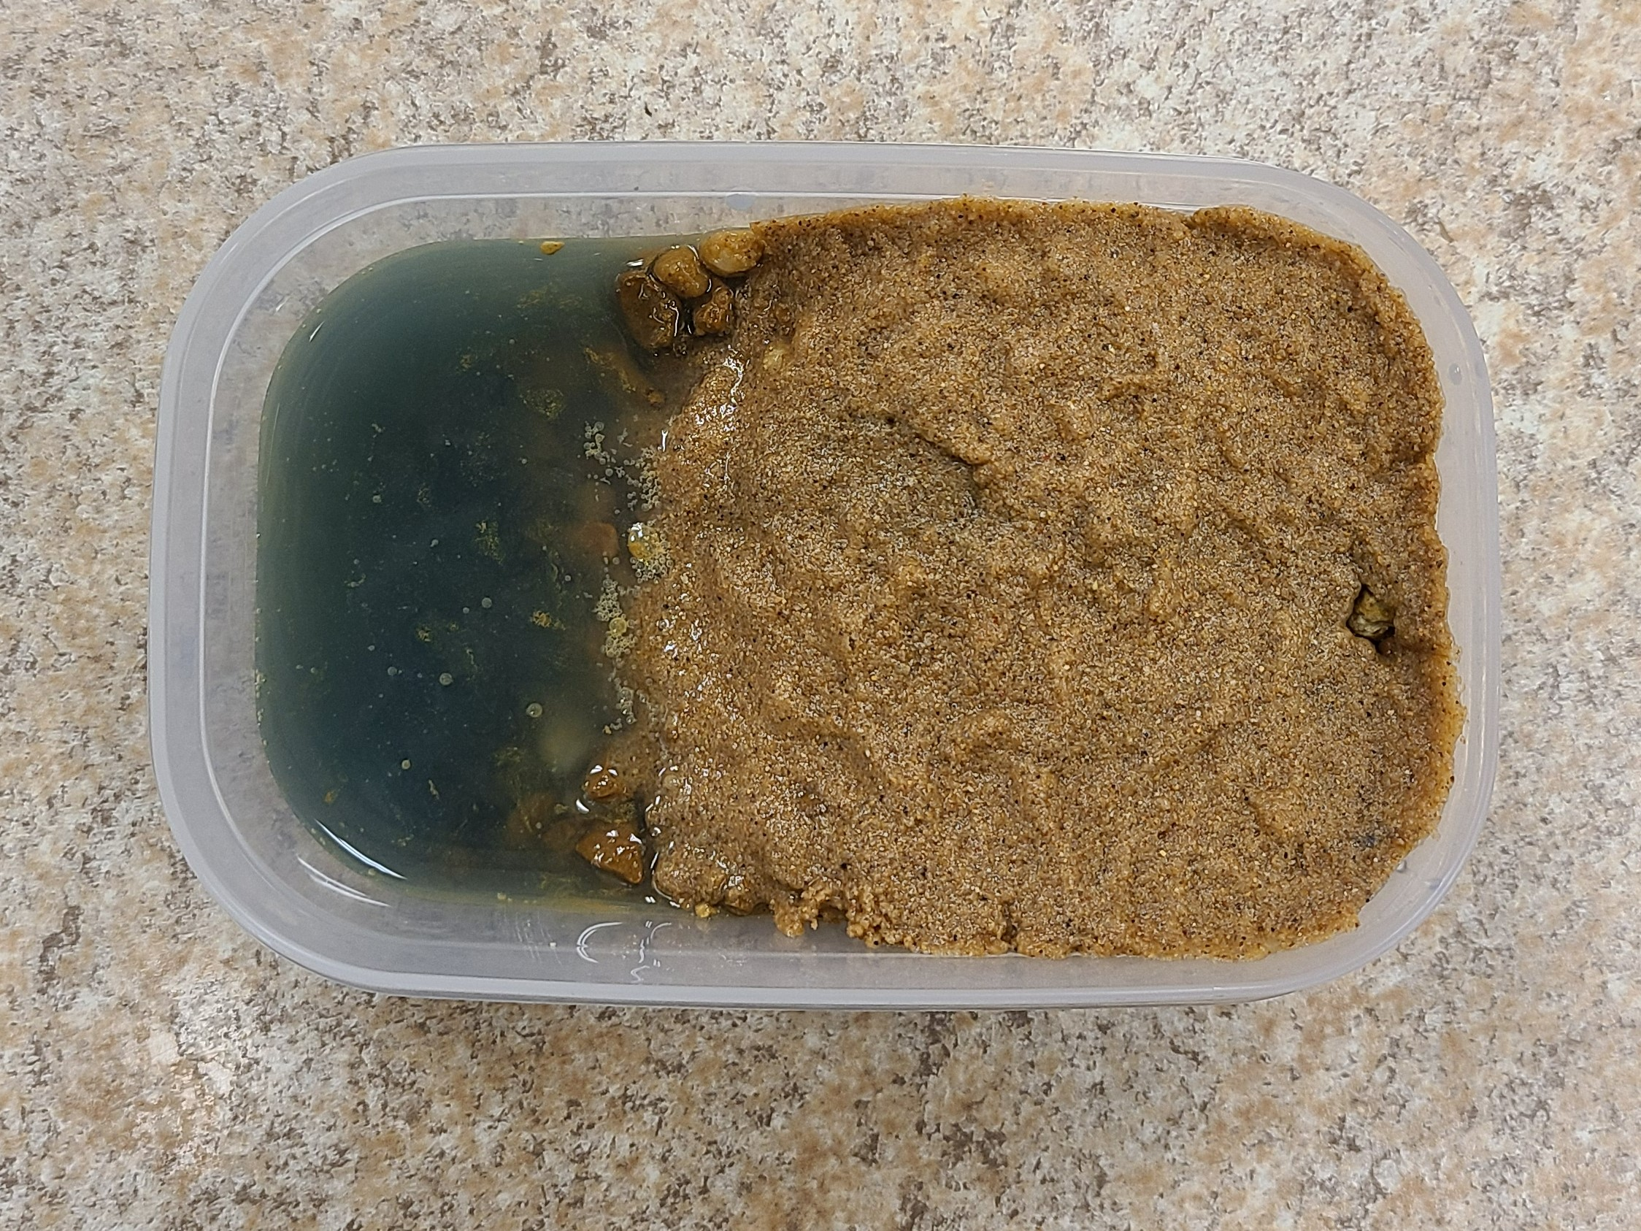
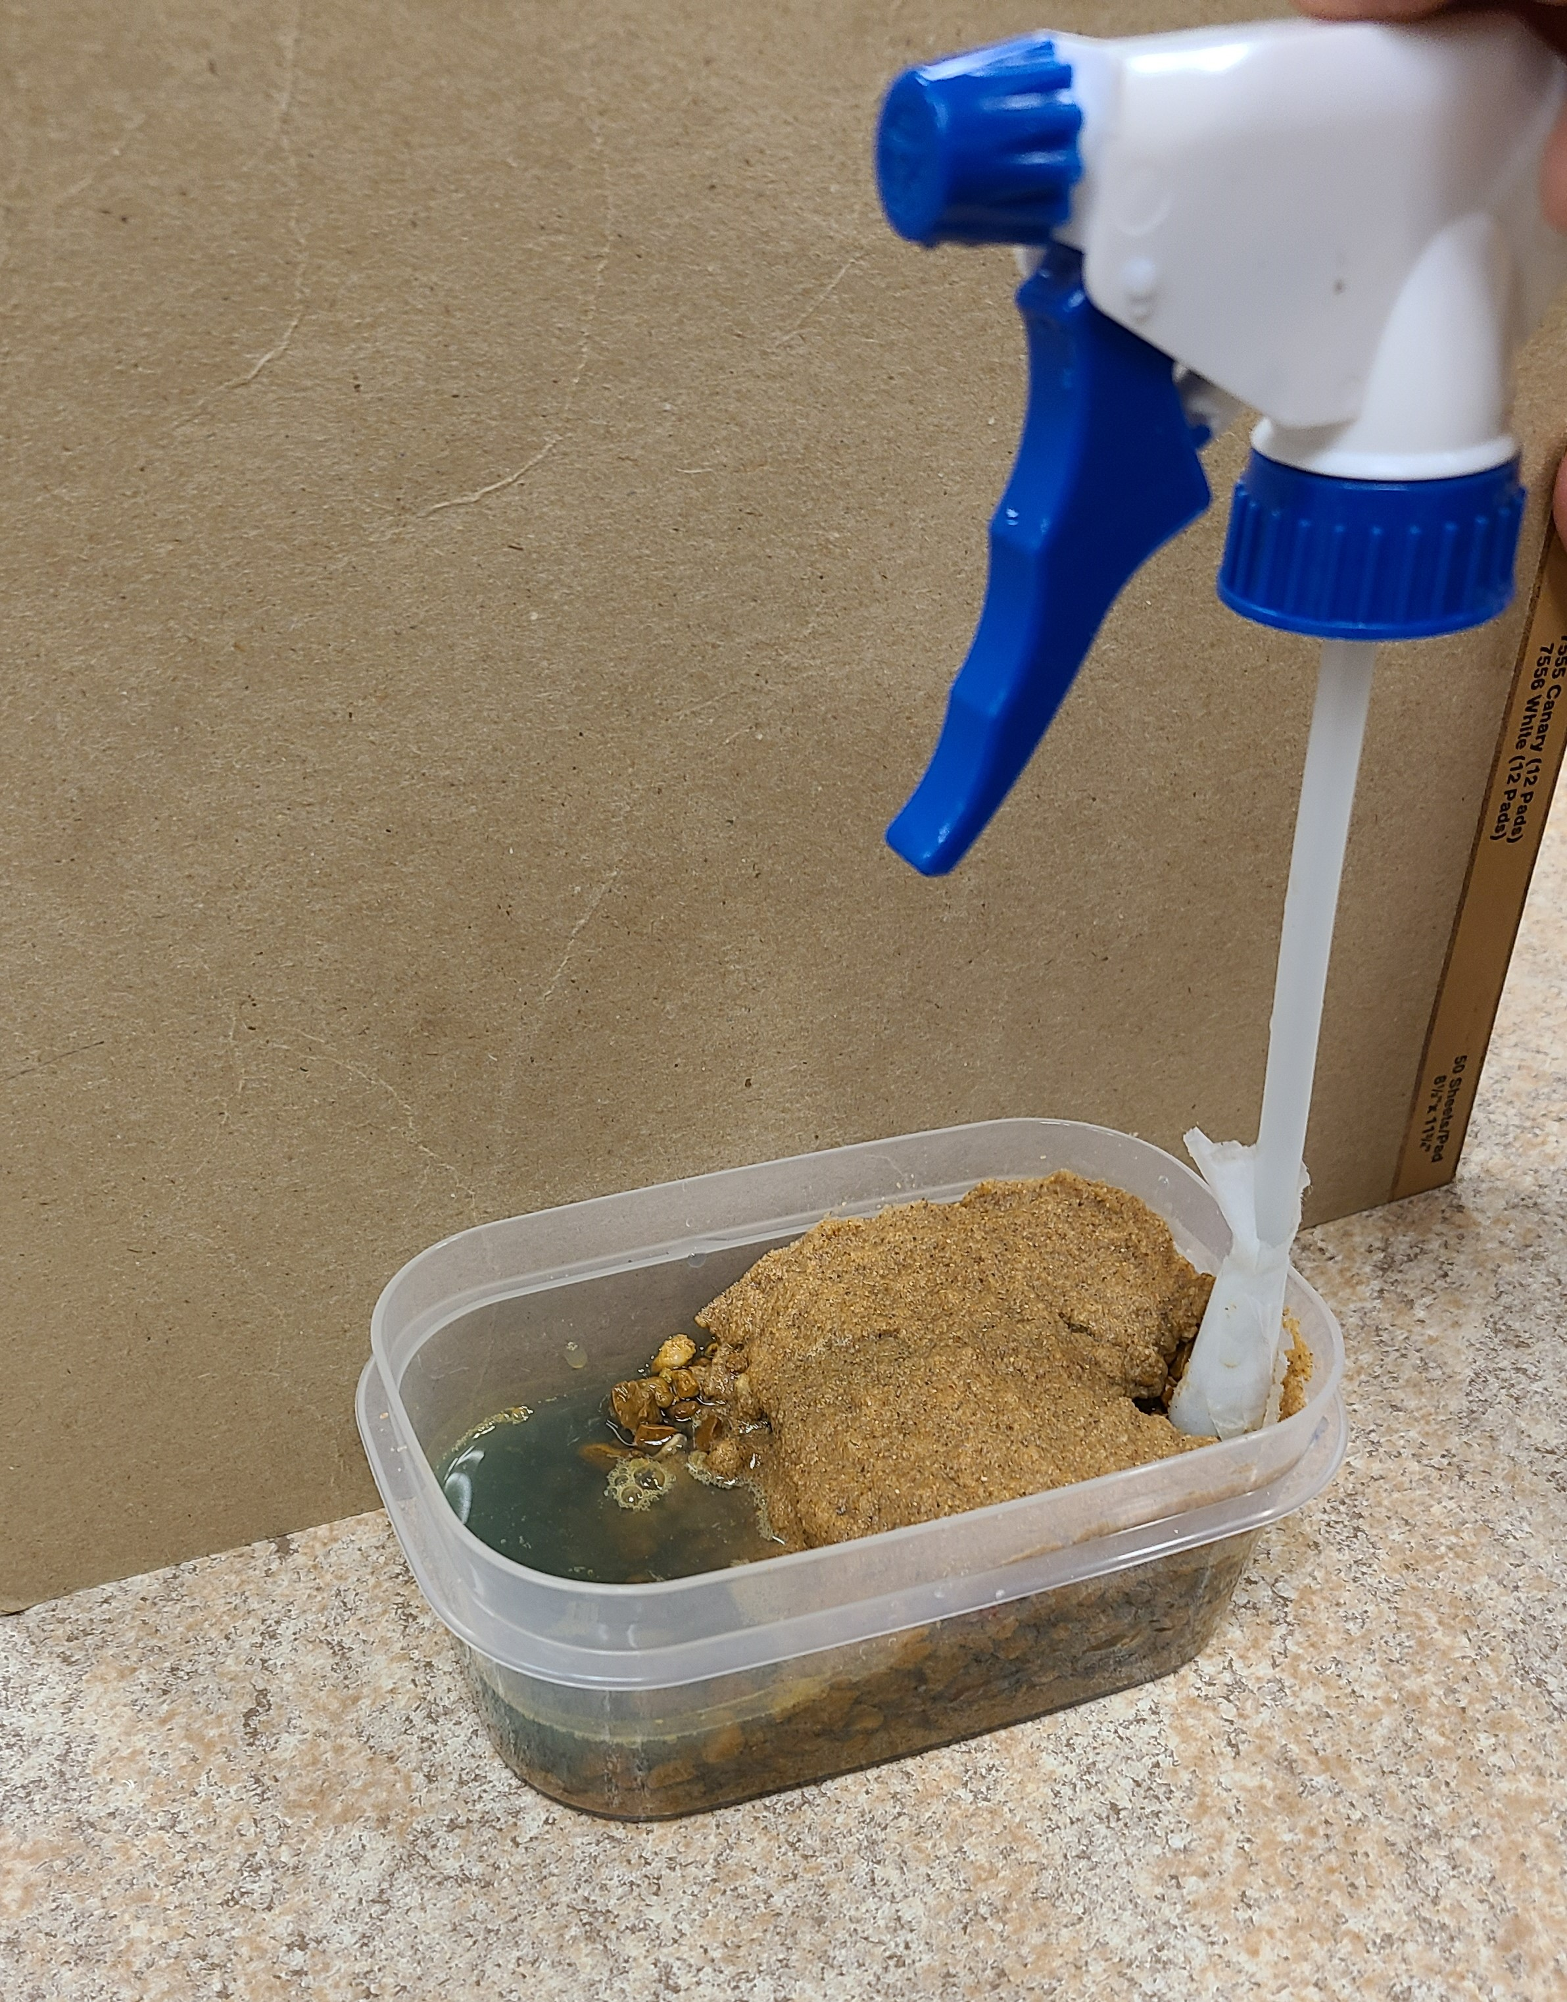
Building an Aquifer
Step 1
Step 2
Step 3

Slide 6
Why Should We Conserve Water?
Fresh Water (3%)
Available water - 0.5%
Unavailable water - 2.5%
          Ice caps, glaciers - 68%
          Ground water – 30%
6

Slide 7
How We Conserve Water in Agriculture
Raise plants and animals that require less water.
Decrease evaporation by covering the soil with mulch.
Build water harvesting/reuse systems and improve irrigation management.
Store and apply farm chemicals and animal wastes carefully to avoid polluting groundwater and surface water.

