Slide 1
Agriculture

Slide 2
Food

Slide 3
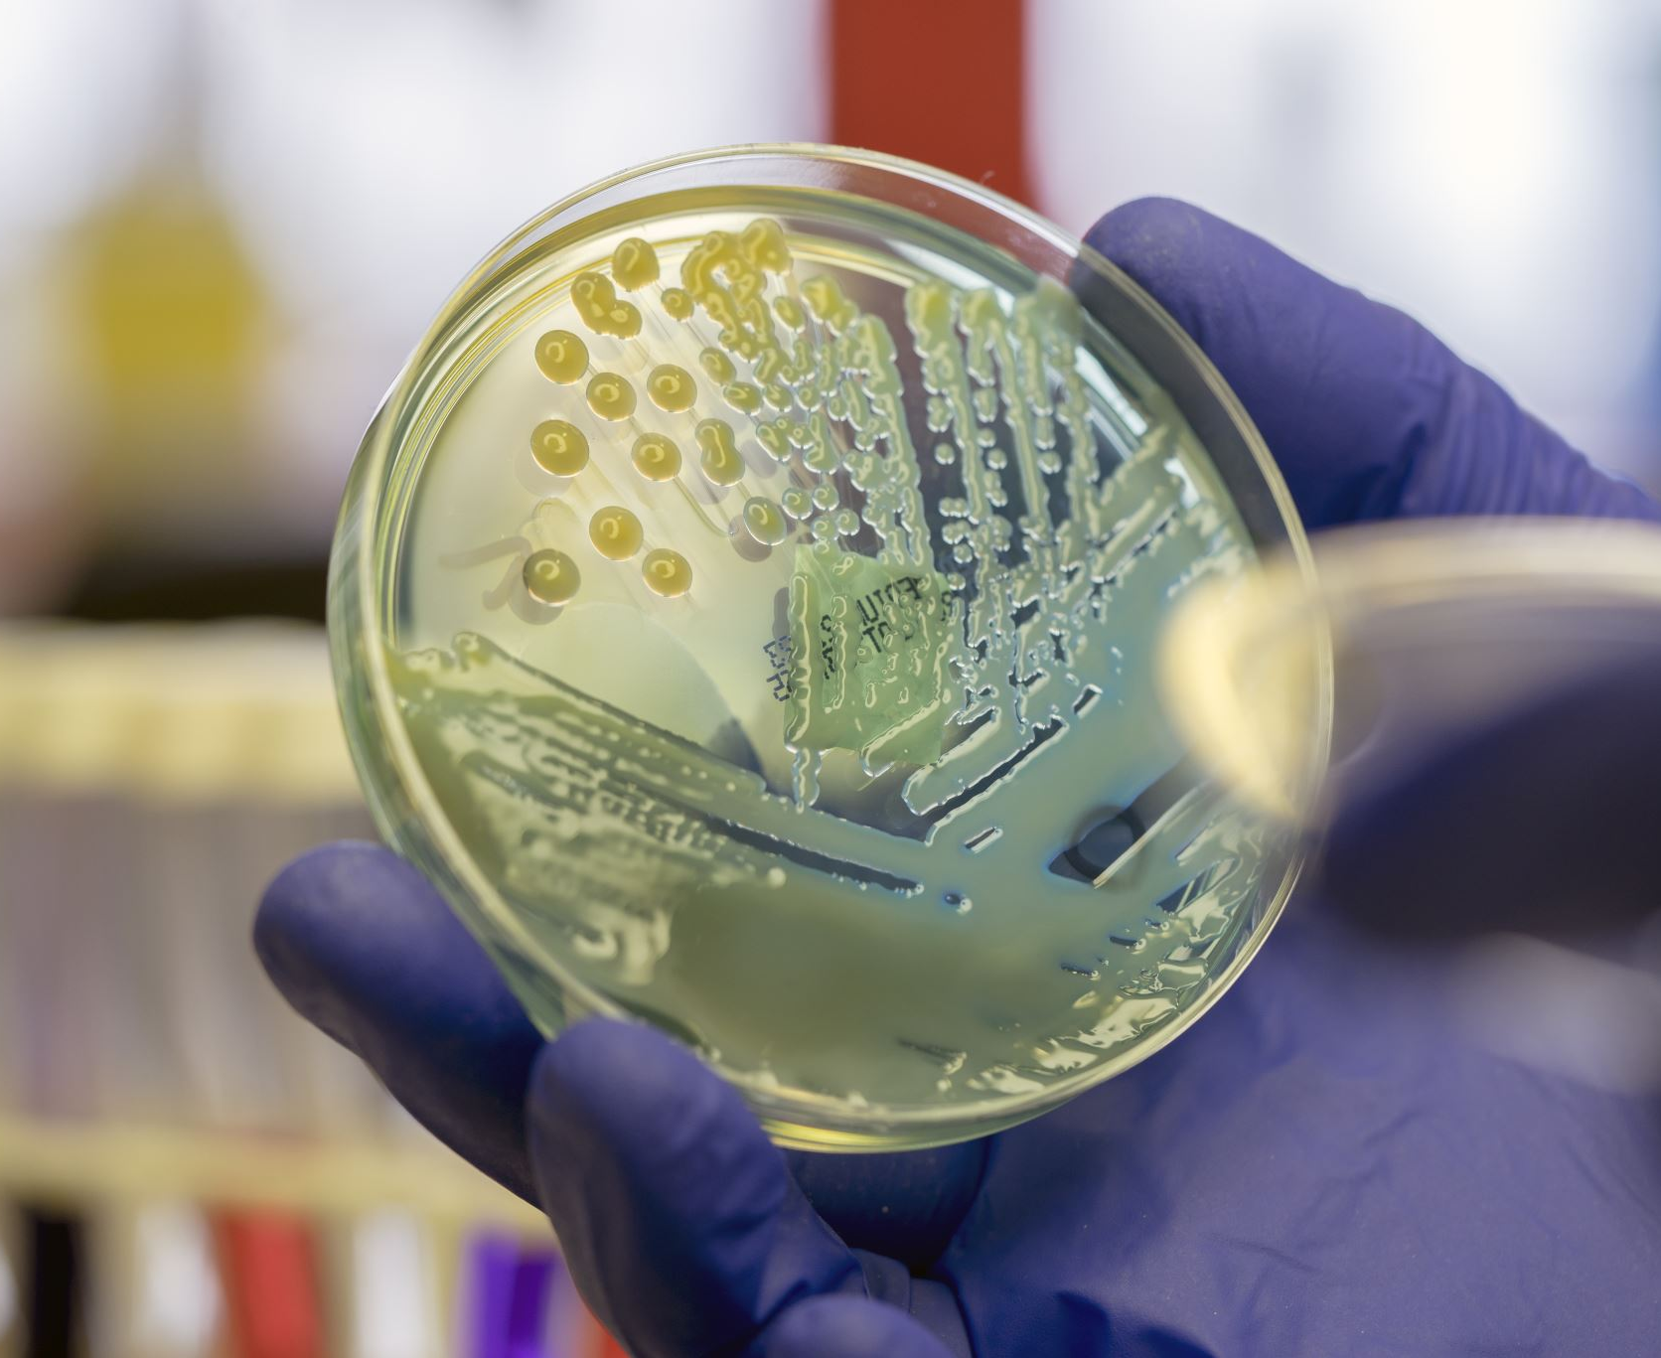
Introduction
Is science involved in producing and cooking food? If so, how?
What are microorganisms? Are microorganisms used or found in food? Are they good? Are they bad?
What makes foods like bread and pancakes rise and become fluffy?
3

Slide 4
Activity
Step 1
Step 2
Step 3

Slide 5
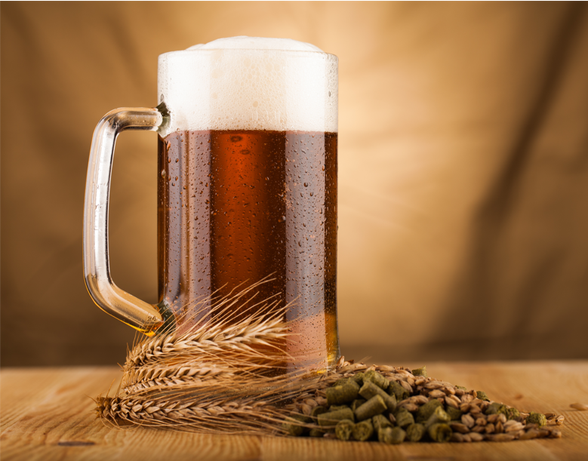
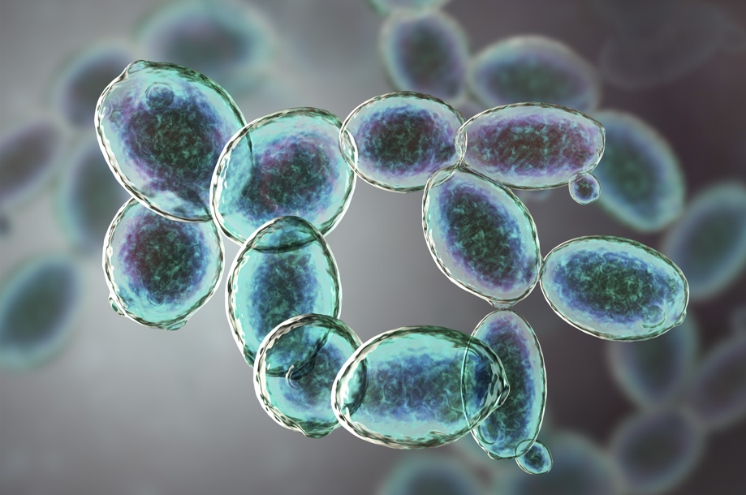
Microorganisms
Yeast
Bread
Beer

Slide 6
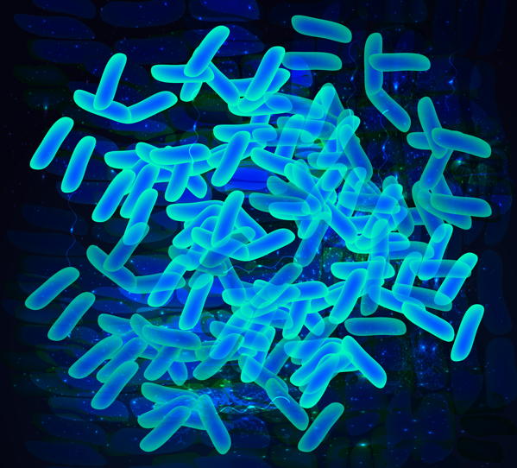
Bacteria in Yogurt

Slide 7
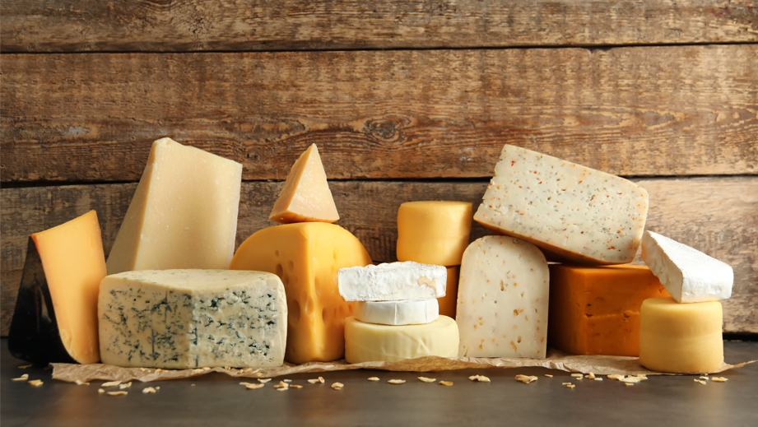
Bacteria for Cheese Production

